Slide 1
Sales Order Attributes
Faizan Ahmed

Slide 2
Overview
  Introduced in Frontier 4.1
  Flexible alternative to Database Free Fields.
  Customize views to display fields (Header).
  Integrate in PCM Configurator using custom keywords.
  Establish relationship between attributes (dependencies).
  MasterFiles allows downloading/uploading functionality
  Allow Sales Order Logging and custom iInquiry.
  Orders with different categories can have different set of attributes.
Notes:
Before - custom order header trailers and free-fields usage.
If you are looking to add more information to your Sales Order:
Sales Order Attributes introduces a more flexible alternative to database free fields (typically suggested method).

Slide 3
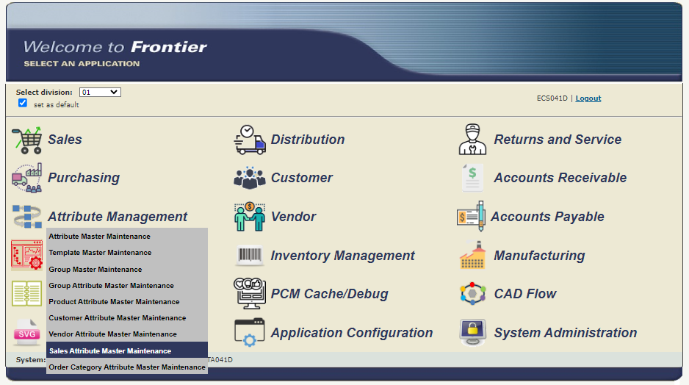
Sales Order Attribute Master UI

Slide 4
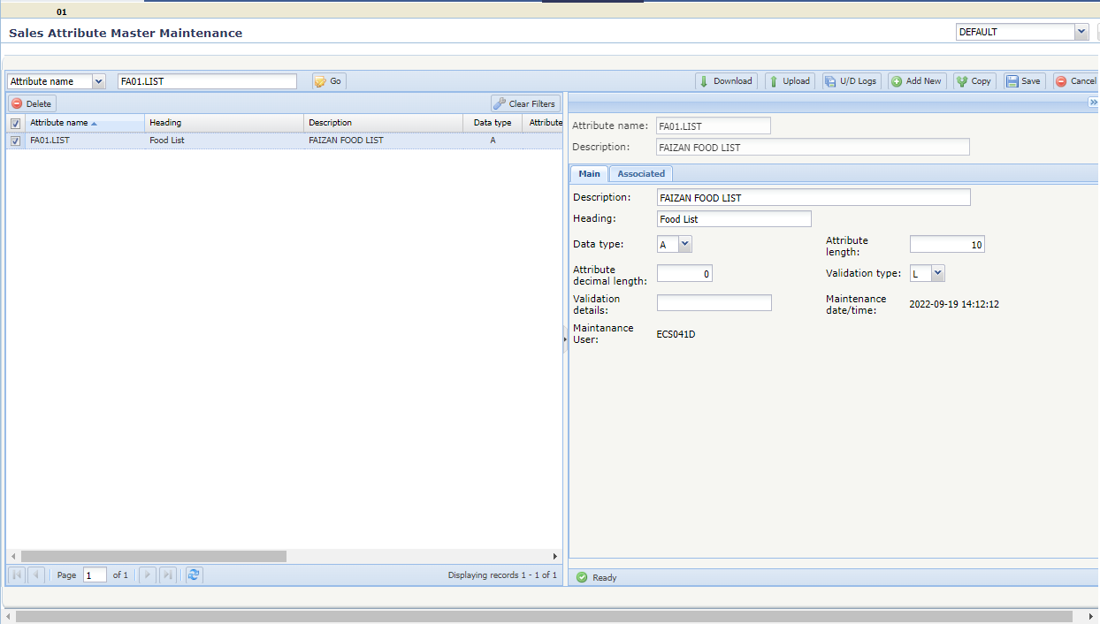
Sales Order Attribute Master UI
  OAMP File
Notes:
Data type can be Alpha-Numeric, Numeric, Date

Slide 5
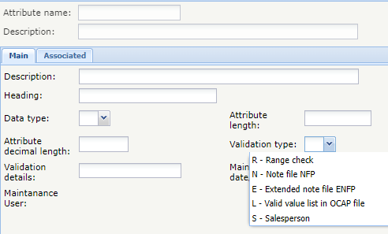
Sales Order Attribute Master UI
Notes:
If Range Check

Slide 6
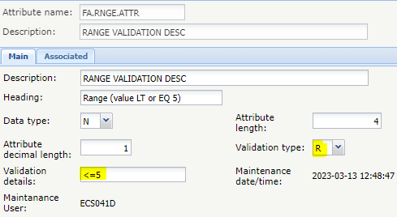
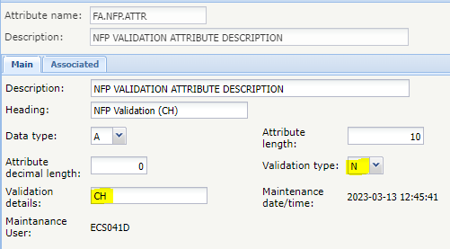
Validation Details
  Blank if Validation Type ‘L’ or ‘S’.
  Populated if following Validation Type selected:
    Range Check
      3-10 (Numeric – Data Type)
      <=*TODAY* (Date – Data Type)
    Note File (NFP) and Extended Note File (ENFP)
Notes:
Validation Type ‘L’ will use the lower-level list create by user in from Order Category Attributes Master UI.
Validation Type ‘S’ will retrieve records from the Salesperson File (SPP).

Slide 7
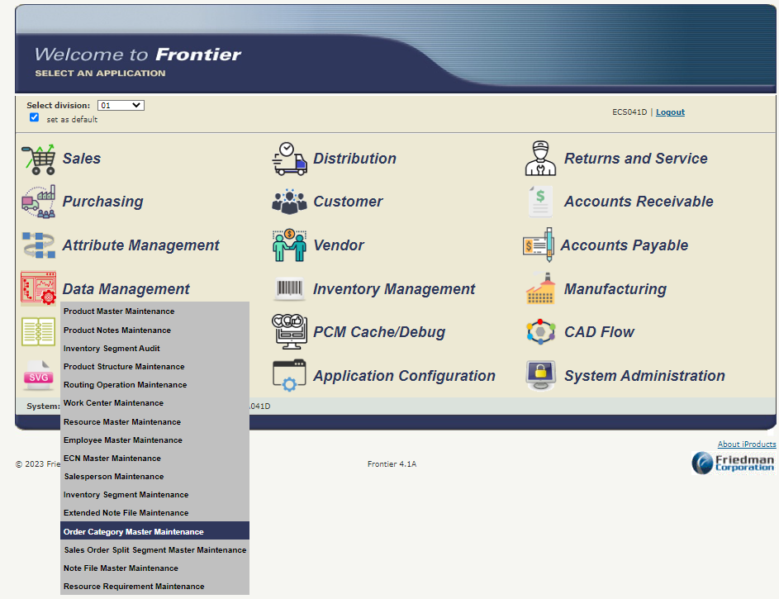
Order Category Master UI

Slide 8
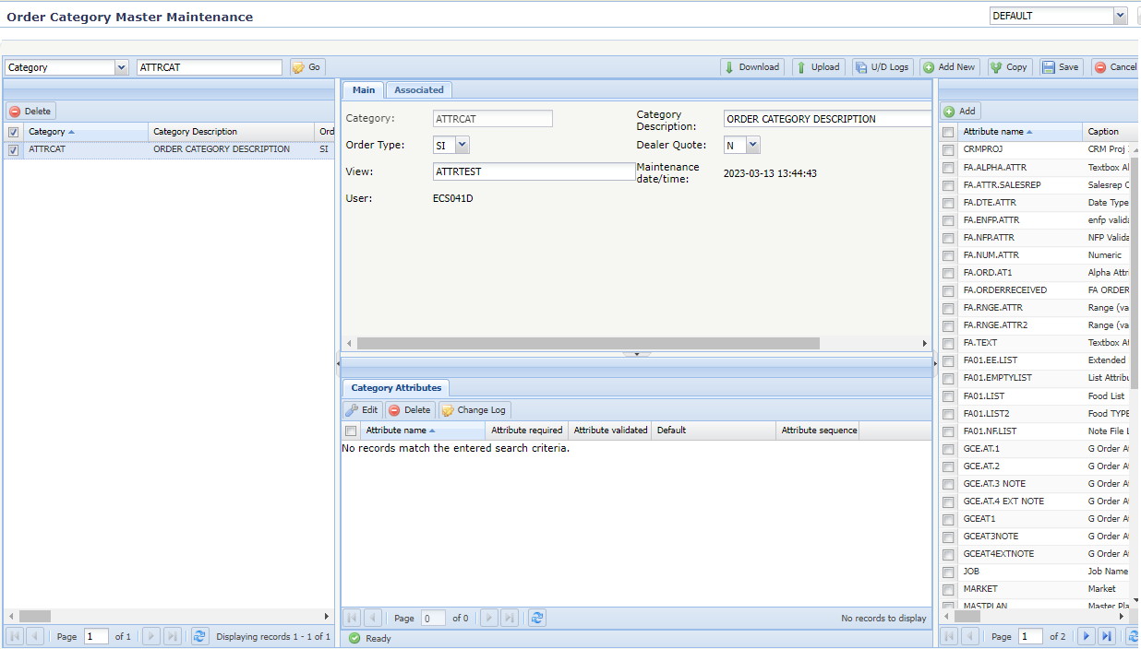
Order Category Master UI
  OCMP File
Notes:
Associate to a Sales Order Entry view. Here I am associating “ATTRTEST” SOEVIEW.
Select order type this applies to. This Order Category is applicable for SI orders.

Slide 9
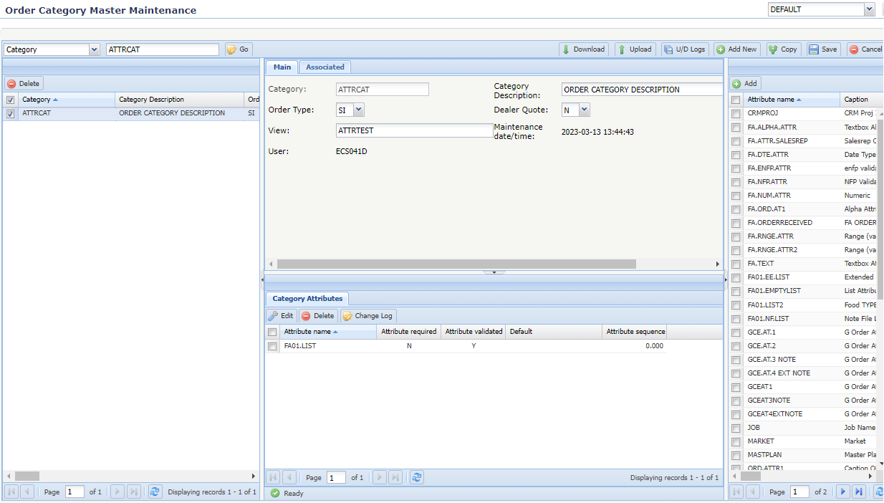
Order Category Master UI
  OTAP File
Notes:
Here you can add the Attributes to the category
For Attribute added to category, you can make it required, validated, update sequence or specify a default value.

Slide 10
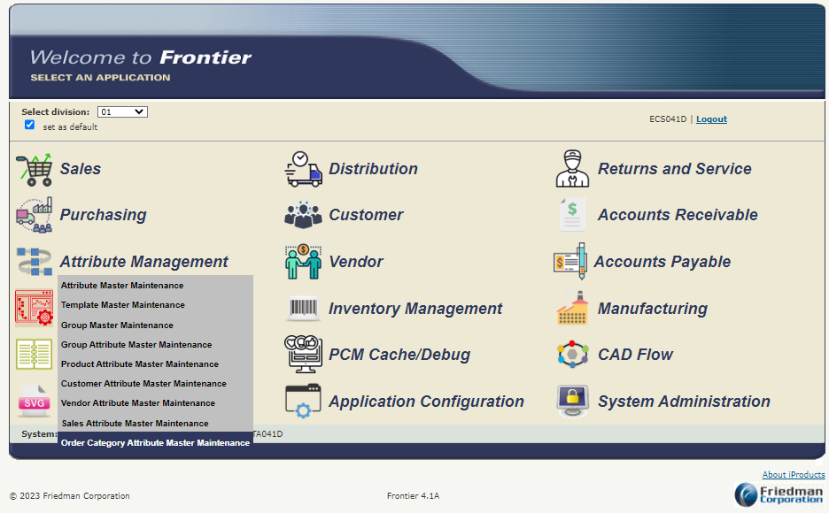
Order Category Attribute Master UI

Slide 11
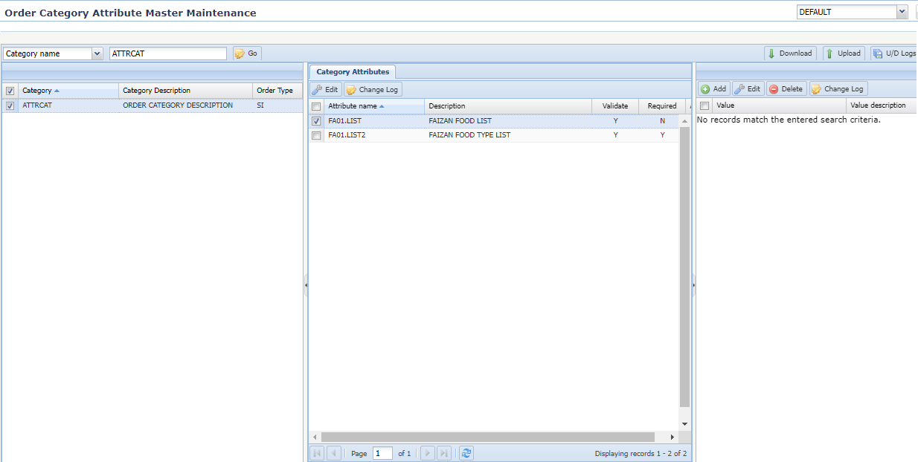
Order Category Attribute Master UI
  OCAP File
Notes:
Here you can specify lower-level values for the Attributes, if the validation type is ‘L’ in Sales Order Attribute UI.
You can also update attributes to be validated, required, and update Attribute Sequence#.

Slide 12
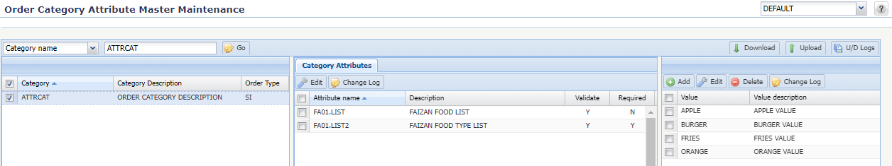
Order Category Attribute Master UI

Slide 13
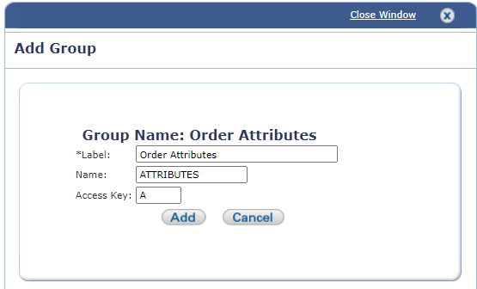
Customize Sales Order View
  Add group named “ATTRIBUTES”

Slide 14
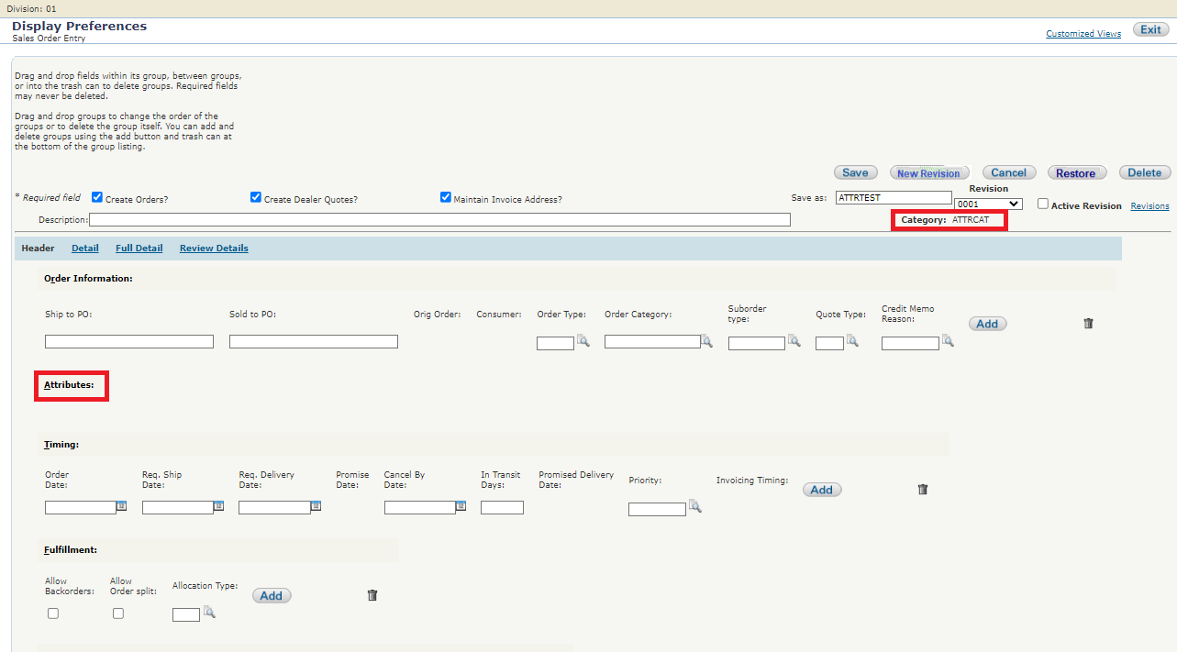
Customize Sales Order View

Slide 15
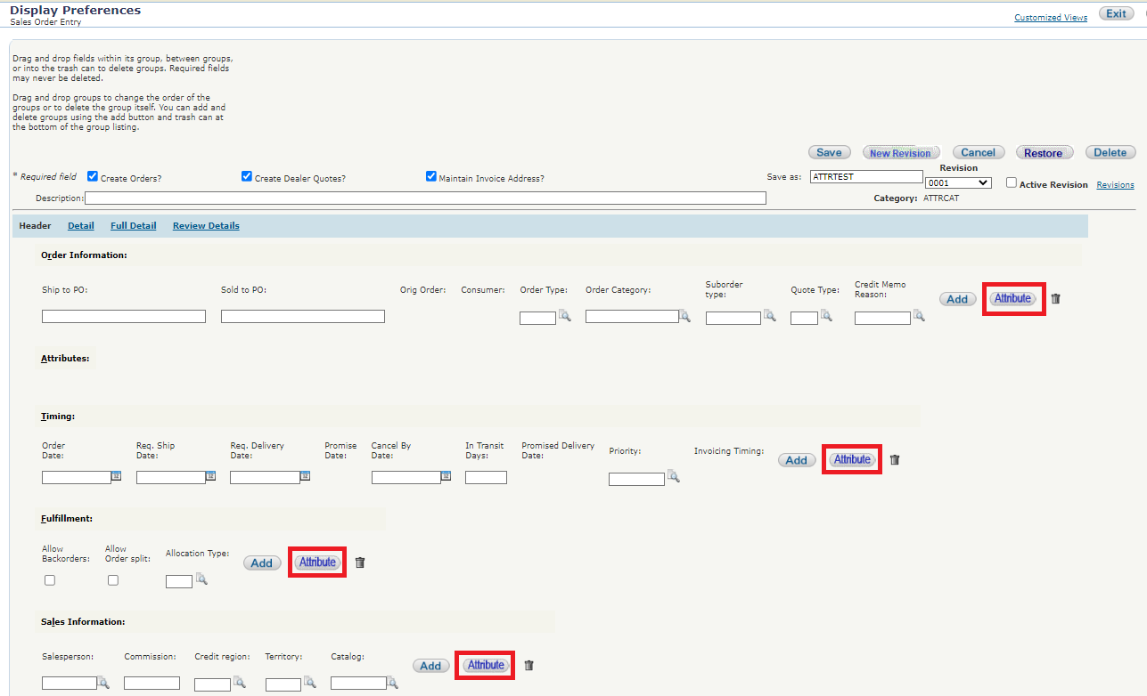
Adding Attributes to Sales Order View
  EC 53966
Notes:
Newer enhancement allows to add attribute to specific groups.
Any attribute not adding to a specific group will show under the Attribute group.

Slide 16
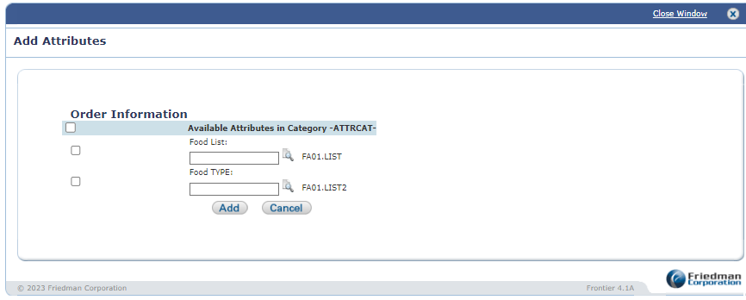
Adding Attributes to Sales Order View
  EC 53966

Slide 17
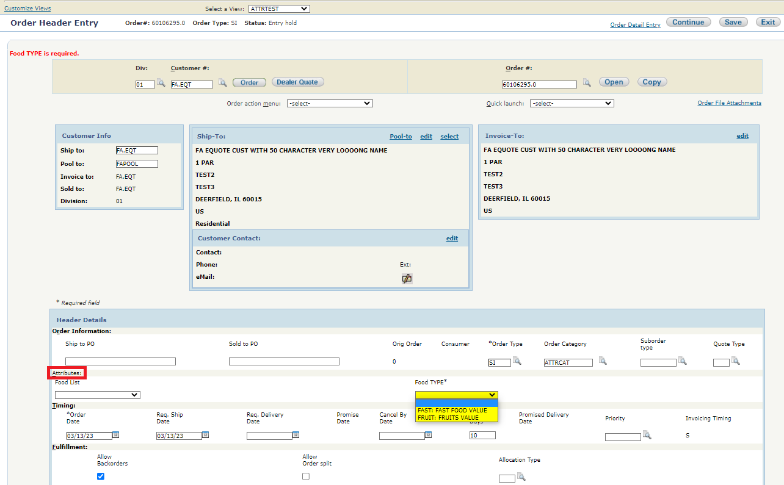
Sales Order Header
  OHP.OHCATG
  OAP File

Slide 18
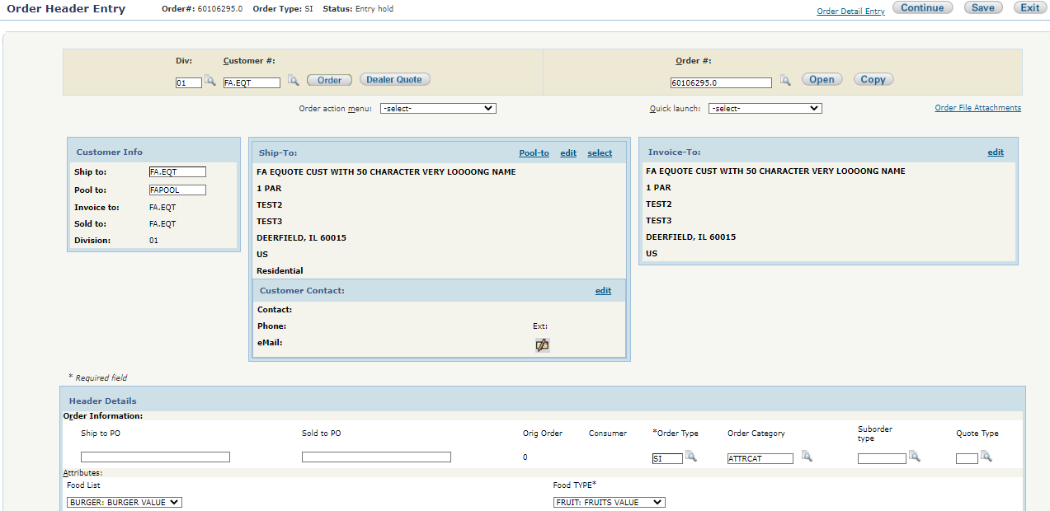
Sales Order Header

Slide 19
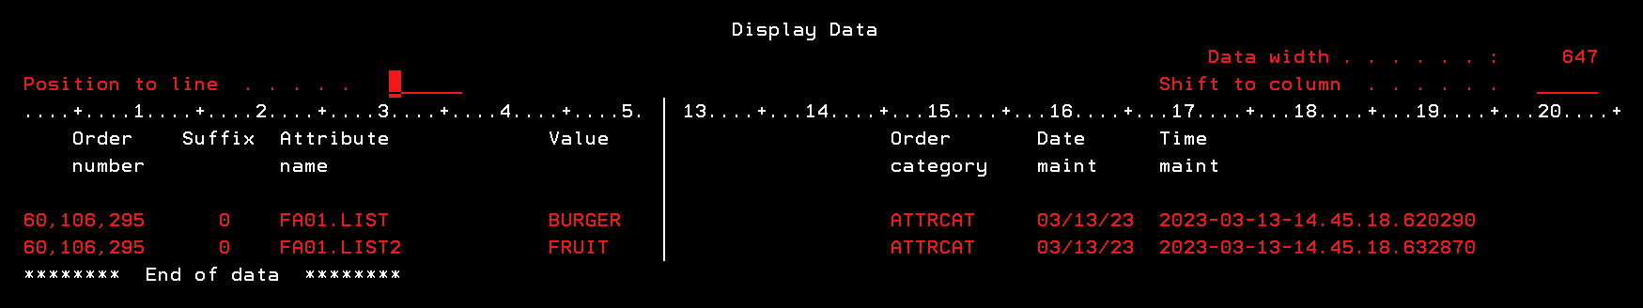
OAP File

Slide 20
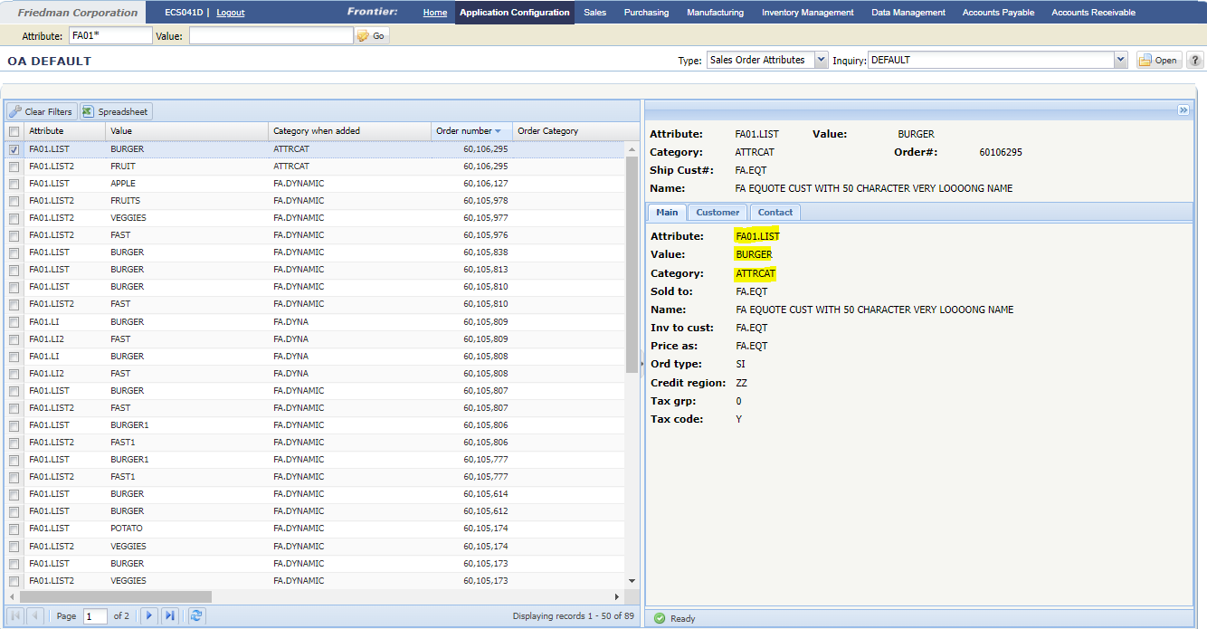
Custom iInquiry
  EC 53987

Slide 21
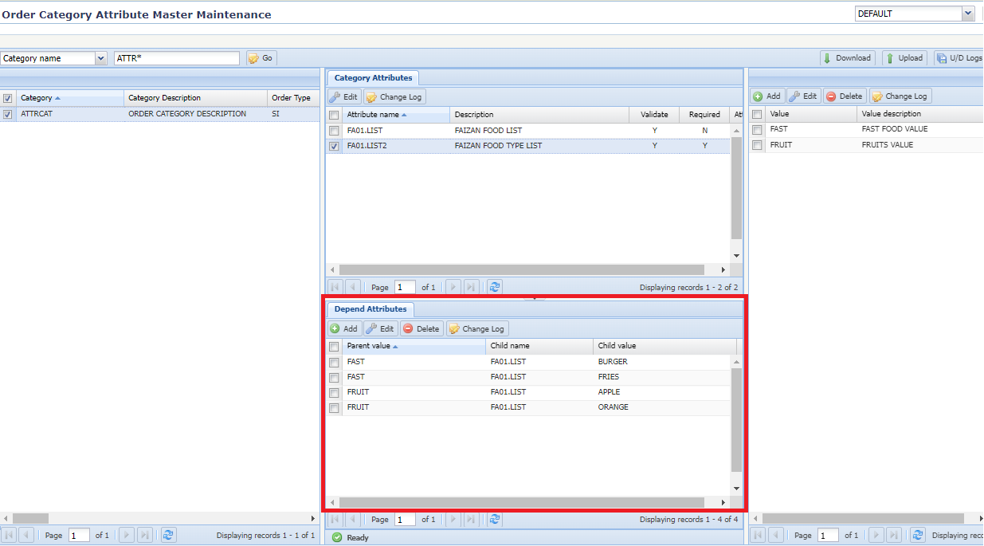
Dependent Attribute
  EC 54294
  Supported only for
  Alpha-numeric
  Data Type.
  A child attribute with
  only one parent
  attribute.
  OASP File

Slide 22
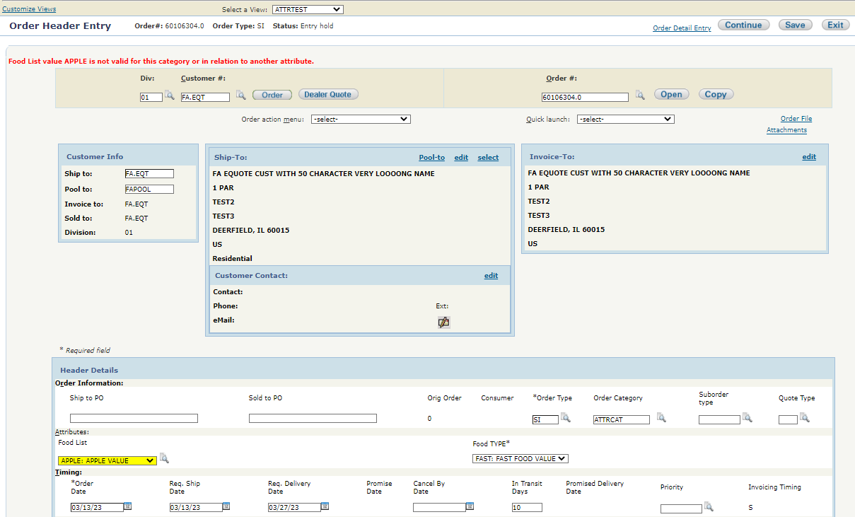
Dependent Attribute

Slide 23
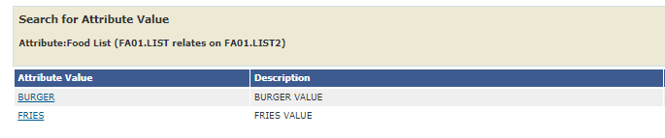
Dependent Attribute

Slide 24
Sales Order Attribute Keyword
  Naming convention &@<type><name>
    &@ - indicates attribute keyword
    <type> - needs to be ‘O’ Order Category Attribute
    <name> is the name of the Attribute

Slide 25
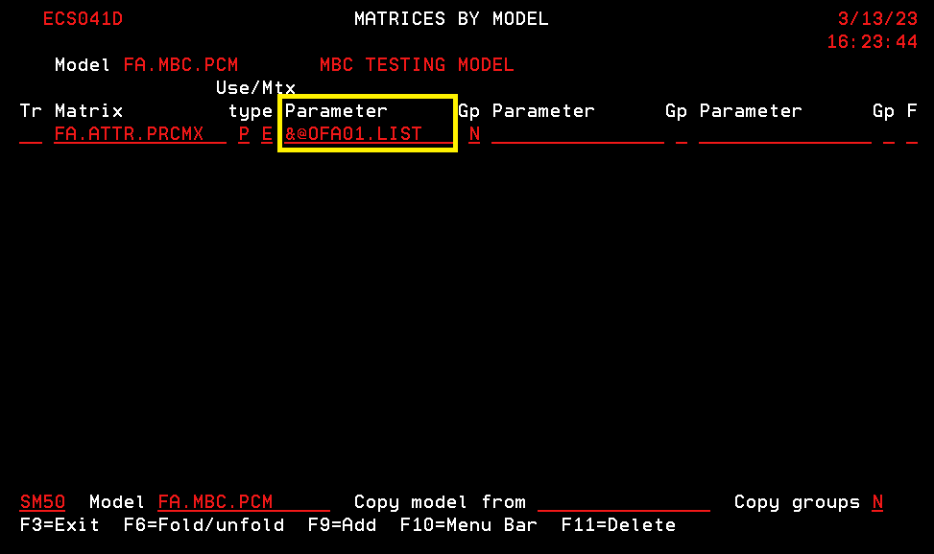
Sales Order Attribute Keyword
Notes:
Note: The keyword can be used in SM46 conditions, SM49 rules, and SM50 matrices etc. just like base keywords and SM93 custom keywords.

Slide 26
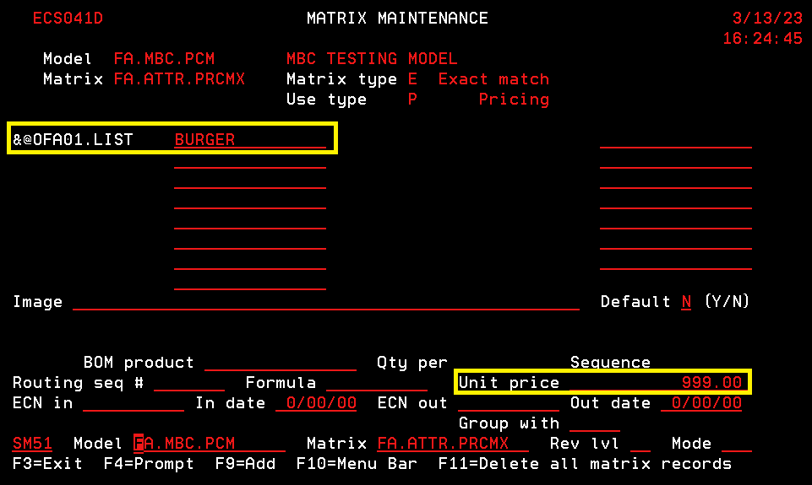
Sales Order Attribute Keyword

Slide 27
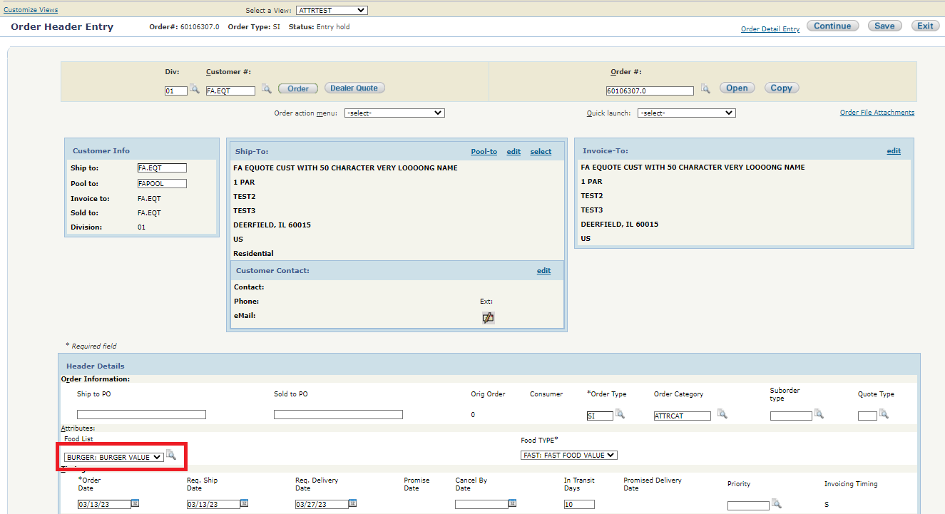
Sales Order Attribute Keyword

Slide 28
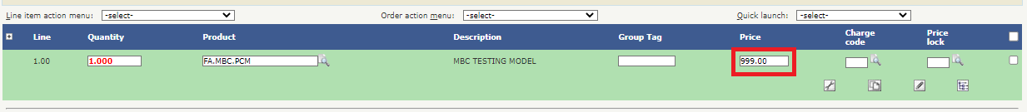
Sales Order Attribute Keyword

Slide 29
Thank you
https://friedmancorp.itclientportal.com/ClientPortal/Login.aspx
Friedman customer support: (847) 948 7180, Ext 7
Notes:
This is a great replacement for the custom order header trailers and free-fields usage.

