Slide 1
Today’s Topic: Internal Purchasing
JAN CUSHING| friedman customer support

Slide 2
The Details
All participants are muted.
Please post your questions in Chat or use the Q&A tab. We will answer them at the end of the presentation.
This session is being recorded. The replay link will be sent to all registered customers.
Presenter: Jan Cushing, Customer Support Representative at Friedman Corp.
  22 years’ experience; Frontier financial systems expert

Slide 3
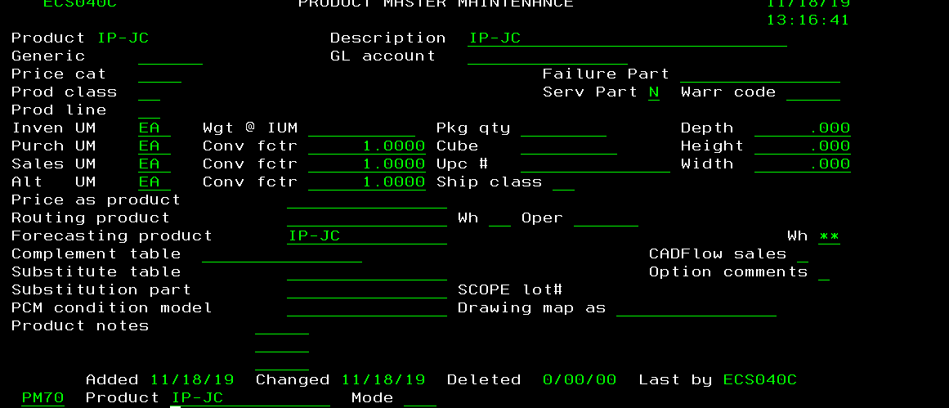
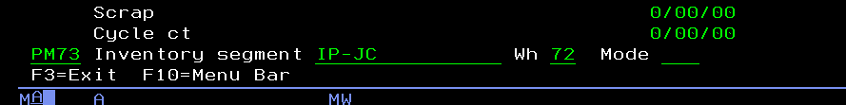
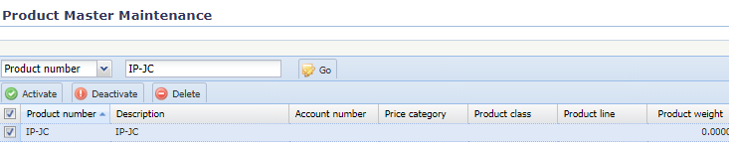
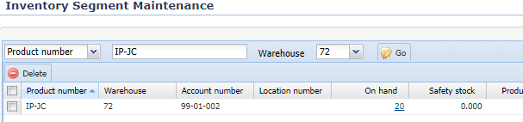
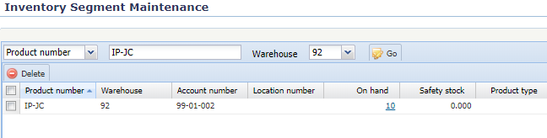
Internal Purchasing
The setup
    For this example set up wh 72 gets the product from wh 92
  Setup an intercompany part in both the shipping and receiving warehouse (PM70/73 or Product Master Maintenance and Inventory Segment Maintenance)

Slide 4
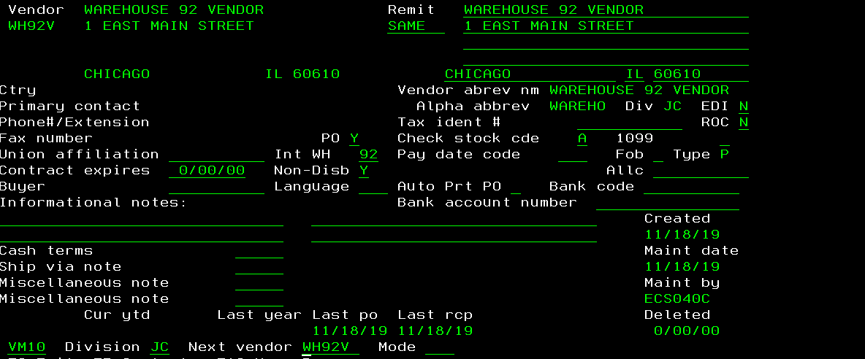
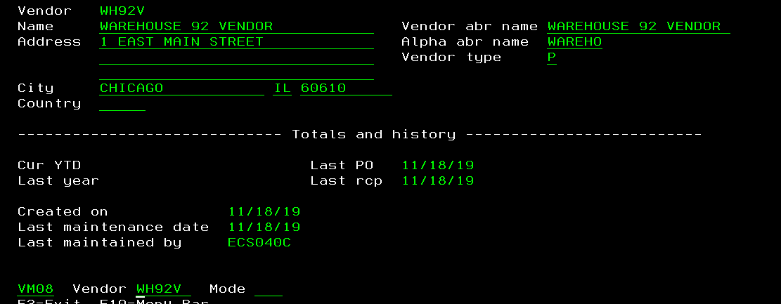
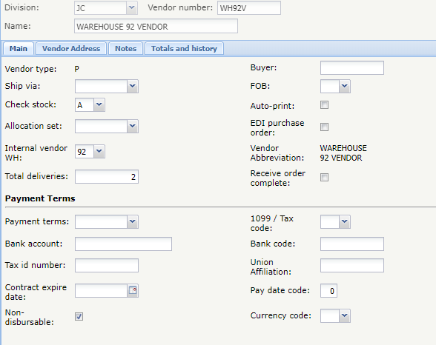
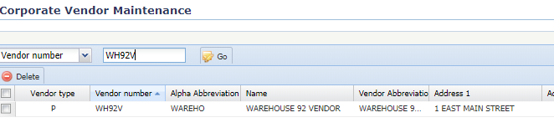
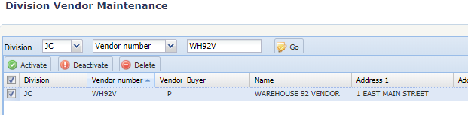
Internal Purchasing
  In the RECEIVING warehouse, you need to setup a vendor in the vendor master (VM08 and VM10 or Corporate Vendor Master and Division Vendor Master Maintenance)
    This vendor is going to be used when converting the req to a PO in the receiving warehouse.
    Put 92 in the Int Wh field in VM10. Put a Y in the Non-Disp field.
    WH92V for Warehouse 92 Vendor example

Slide 5
Internal Purchasing
Disbursable Internal Vendors External vendors are always disbursable; internal vendors may be either disbursable or non-disbursable.
  If disbursable, payables processing same as an external vendor:
    ■ PO receipts vouchered in AP65.
    ■ AP open items are created.
    ■ Payables are booked to the normal AP trade account.
    ■ Open items paid by check using normal selection process.
If not disbursable, no AP processing is required:
    ■ Internal PO receipts for an internal vendor cannot be vouched in AP65.
    ■ No open AP items are created.

Slide 6
Internal Purchasing
  Create a quote for the intercompany part for WH92V vendor (QM11 or Vendor Quote Master Maintenance)
  Create an interbranch customer (customer type = B) for the receiving warehouse (in the shipping WH). (CM50 and CM52 or Corporate Customer Master Maintenance and Divisional Customer Master Maintenance)
    This is going to be the customer master that is used to create the SI order in the shipping warehouse.
    WH72C for Warehouse 72 Customer example.
  Create a price for the intercompany part for WH72C customer in the price list (PR81)

Slide 7
Internal Purchasing
  In the NF68 note file
    In the OT note file, setup an IP type for intercompany purchasing
    In the SO note file, setup a type for each receiving warehouse. The first 6 characters of the description are reserved for the customer master.
      Type = 72 would have WH72C in the first 6 characters of the description.

Slide 8
Internal Purchasing
  Create the following alpha codes in your Chart of Accounts (AC69 or Chart of Account Maintenance)
    IPRswrw: Internal Purchasing Receivable
    IPPrwsw: Internal Purchasing Payable
    IPVrwsw: Internal Purchasing Price Variance
      sw = Supplying warehouse
      rw = Receiving warhouse

Slide 9
Internal Purchasing
The process
  In the receiving warehouse, a req will be created either by MRP or thru the configurator
    If this is configured, you should see a work order in the shipping warehouse to show requirements. You will NOT be able to produce this until the req is converted to a PO.
  Make sure the req is assigned to the WH10V vendor. This identifies where you want to ‘purchase’ this product (Wh 10 in this example)
  Convert the req to a PO in APE
    When you convert to a PO, an SI order is created in the shipping warehouse. The customer that is used is going to be the customer that was identified in the SO note file.
  This SI order has to be produced and shipped
  Once received, the PO should be received in the receiving warehouse.
Need to have EDI async ORD400 running.
If no order created check async log for issue.

Slide 10
Internal Purchasing
Internal Purchasing Receipts Close (APJ185)
  APJ185 journals the receipts made against a non-disbursable internal vendor purchase order. The journal entry created has the identifier IPxxx. Processed receipts will be marked as “vouchered”.

Slide 11

Questions and Answers

