Slide 1
Today’s Topic: Installing iStatements
Jan cushing|internal support consultant

Slide 2




Introductions

Slide 3
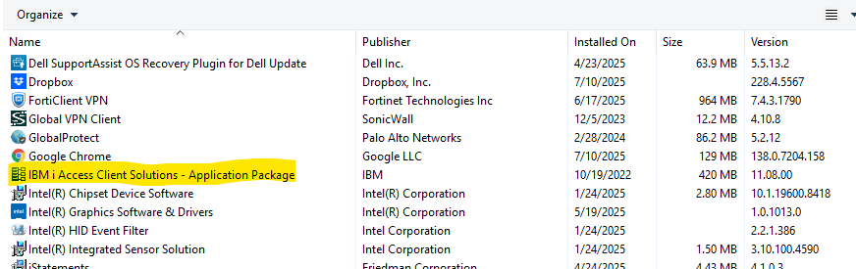
Installing iStatements
System Requirements
  IBM iAccess Client Solutions and the Windows Application Package
        Go to Control Panel
        Click on Programs and Features

Slide 4
Installing iStatements
System Requirements
  PC based/installed version of Excel
  iStatements is backwards compatible to all Frontier versions 3.0 and higher.

Slide 5
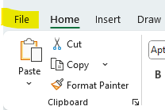
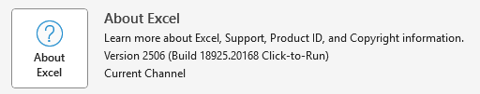
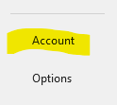
Installing iStatements
  The version of iStatements you install (32-bit or 64-bit) is based on your Excel version.
  To find out your Excel version do the following:
      Open a blank Excel spreadsheet
      Click on File on the toolbar
      Click on Account
      Click on About Excel. At the top of the page, it will tell you if your Excel is 32 bit or 64 bit.

Slide 6
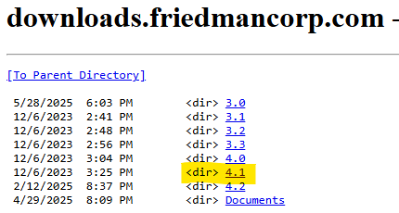

Installing iStatements
  Where to go to download the iStatements program
      The current latest iStatements release is 4.1.0.3 but check in release 4.2 to see if there is a new iStatements there.
      Go to http://downloads.friedmancorp.com/Friedman/ClientDownloads/
      Click on 4.1
      Click on iStatements
      Click on iStatements v4.1.0.3.zip to download

Slide 7


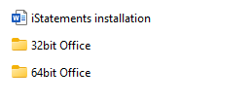
Installing iStatements
    The download will be a zip file that contains the 32-bit install, the 64-bit install and install instructions in your Download folder.
    To do the install you need to extract ALL out of the zip file.
    The iStatements install folder must be on the C drive of the computer you are installing the program onto.

Slide 8

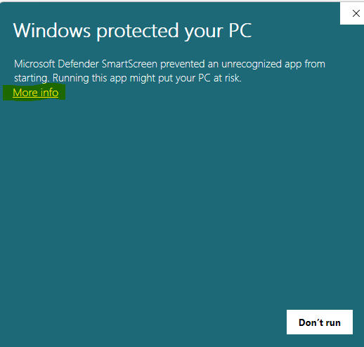
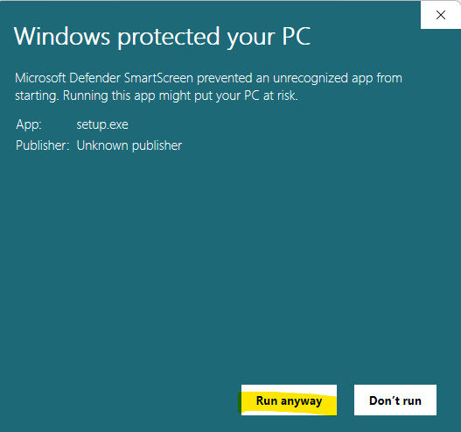
Installing iStatements
  If installing iStatements on a computer that has never had iStatements installed on it, click on either the 32bit or 64bit Office folder based on your Excel version. If the computer already has a version of iStatements installed, you must first uninstall the current iStatements and VBExcel and then install the new version of both.
  Right click on the Setup and click on Run as Administrator.
  You may see screen called Windows protected your PC (see below). Click on More Info.
  Click Run anyway

Slide 9
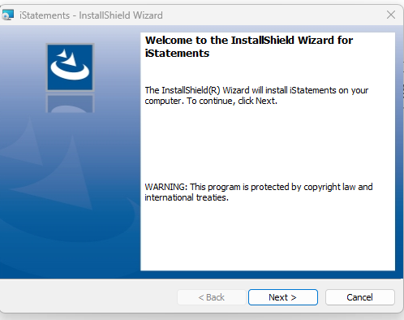
Installing iStatements
  If you are an administrator on your own machine, you will get a popup window stating the program wants to make changes to your system, do you want to allow this. Click Ok.
  If you are not an administrator on your machine, then your IT dept will need to enter user id and password to allow the install.
  The install wizard window will now appear. Click Next.

Slide 10
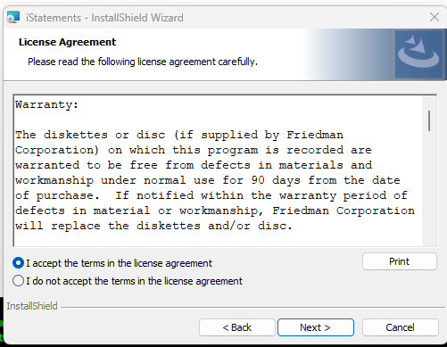
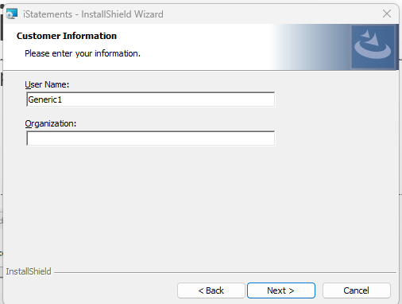
Installing iStatements
  Click to accept the license agreement and then click Next.
  The next screen Customer Information you can enter a user name and organization name but not necessary and click Next.

Slide 11
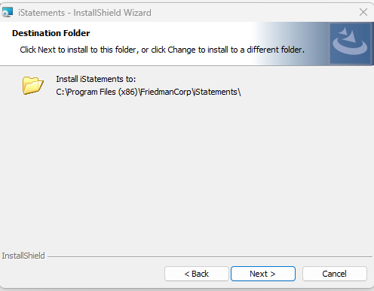
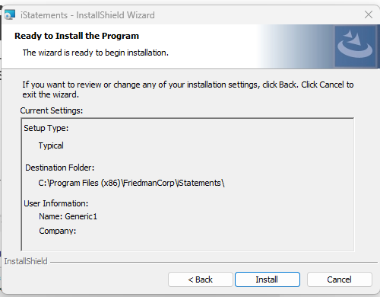
Installing iStatements
  Now the Destination Folder screen displays just click Next.
  Ready to Install the program screen appears and click Install

Slide 12
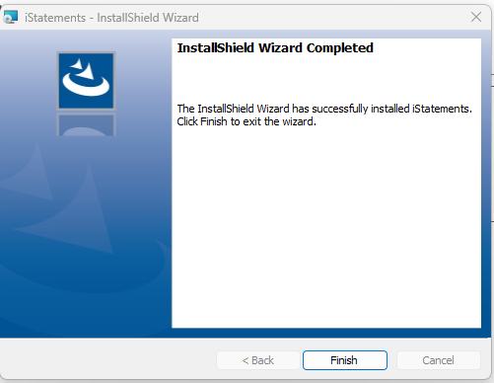
Installing iStatements
  When the install has completed click Finish

Slide 13
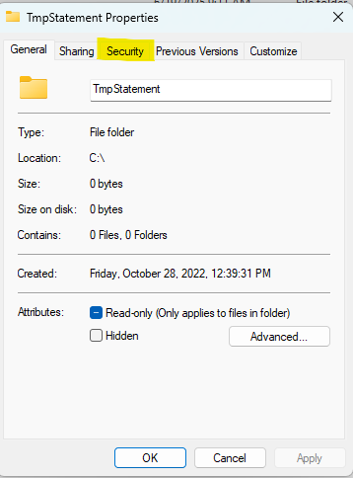


Installing iStatements
  Now go to the C drive on this PC. This will display a list of folders on the C drive for this computer.
  Make sure there is a folder called TmpStatement. If this folder is not there add a new folder and name it TmpStatement.
  Right click on the TmpStatement folder and click on Properties.
  Click on the Security Tab

Slide 14
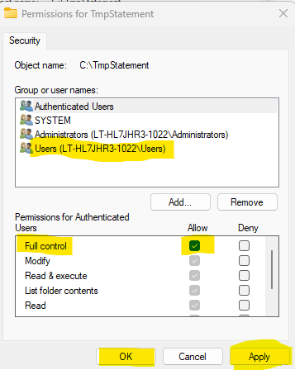
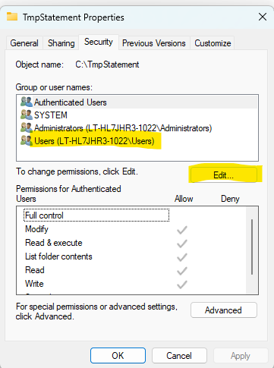
Installing iStatements
  Click Edit and the click on Users.
  On the bottom of the screen click the check box on Full Control in the Allow column.
  Then click Apply and Ok.

Slide 15
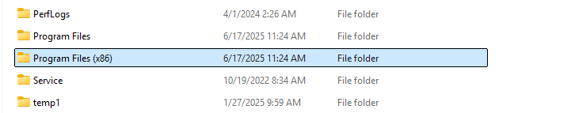
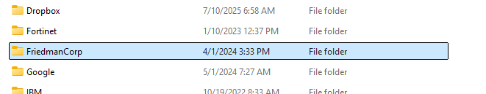
Installing iStatements
  Click on Program Files (x86)
  Right click on FriedmanCorp folder and click on Properties.

Slide 16
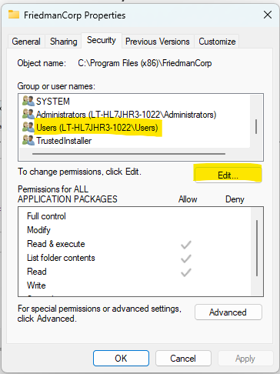
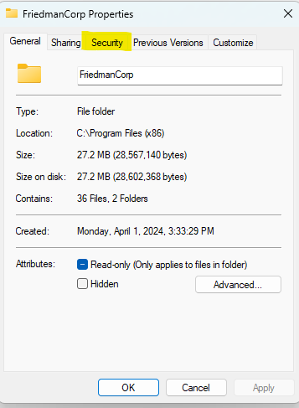
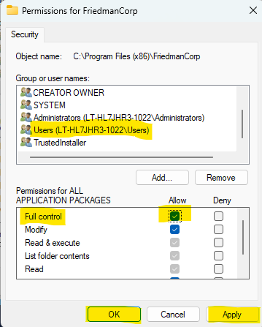
Installing iStatements
  Click on the Security tab.
  Click Edit and click on Users.
  Click in the check box in the Allow column on the Full Control line.
  Click Apply and Ok.

Slide 17

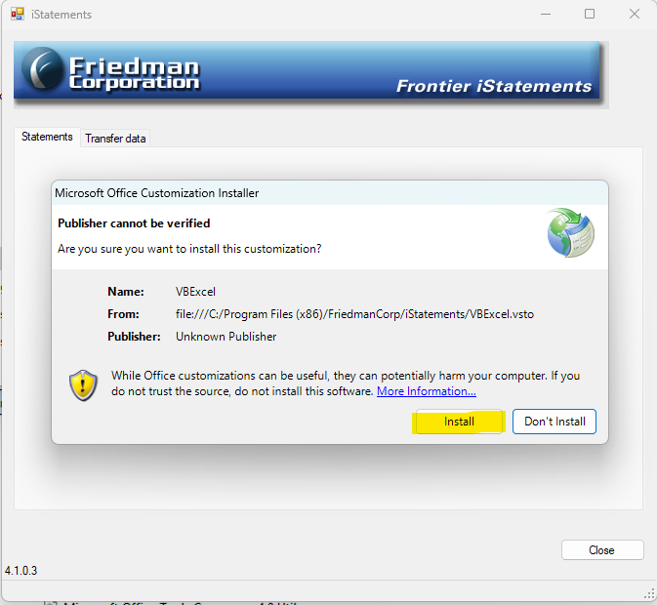
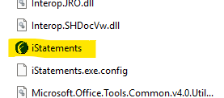
Installing iStatements
  Double click on the FriedmanCorp folder.
  Double click on iStatements folder.
  Right click on iStatements and select Run as Administrator.
  This will bring up a window to install the VBExcel program, click Install.

Slide 18
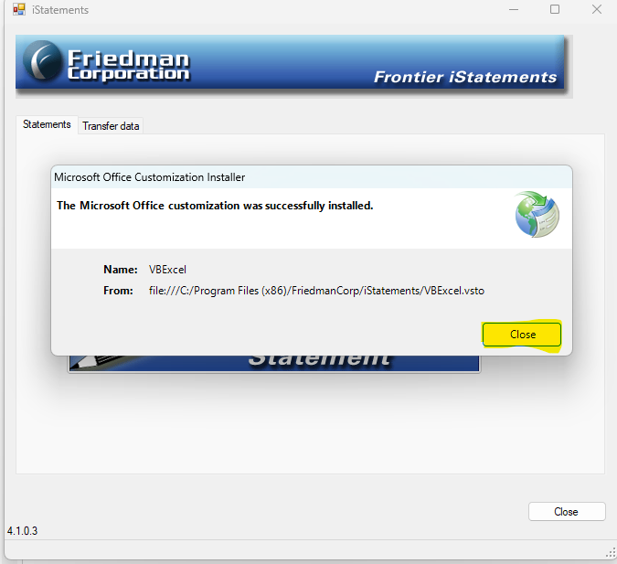
Installing iStatements
  When it is done installing the VBExcel the window will say it was successfully installed. Click Close.

Slide 19
iStatements – Latest Fix
Before moving onto doing a data load please do the following:
There is a current Microsoft issue with creating the FrontierCubesxxxx database information correctly. This should be done by your IT department.
To fix please do the following:
Here is the info of what to delete to help with the FrontierCubes issue where it is not getting created or not updated.
In Windows Explorer navigate to : %localappdata%\VirtualStore\ProgramFiles(x86)\FriedmanCorp
Delete the FriedmanCorp folder in that location and run the Transfer data

Slide 20
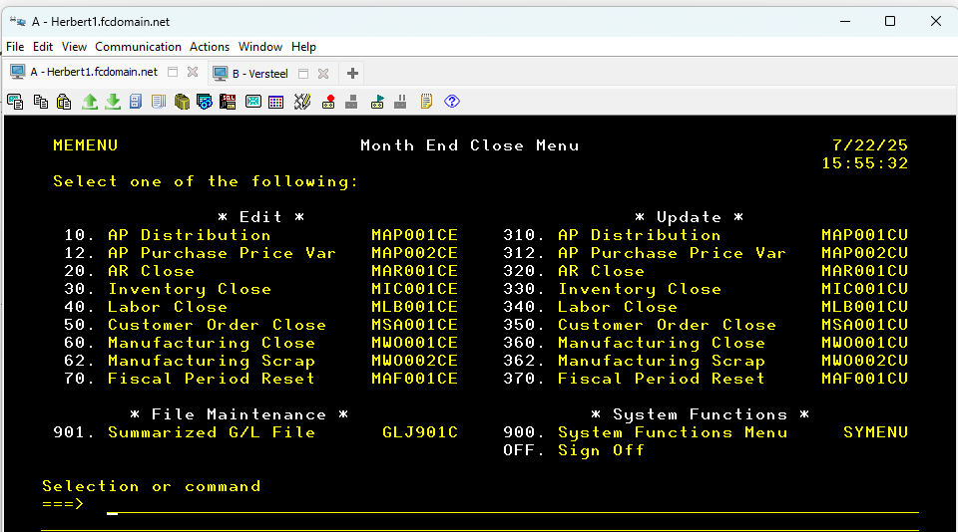
Importing Data
  Before you can use the iStatements program you need to have posted GL journals.
  Log into Frontier AS400 (green screen) and go to MEMENU.
  Run option 901.

Slide 21
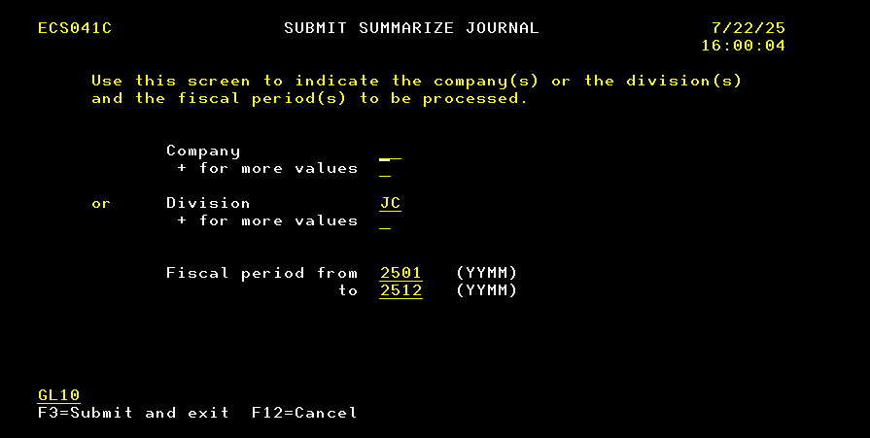
Installing iStatements
  Enter either you Company # or Division and enter the beginning and ending fiscal period.
  Hit Enter and F3 to submit.
  This will populate the JMP file on your system.
  Possibly need EC 52816 and/or EC 53064 for GL10

Slide 22
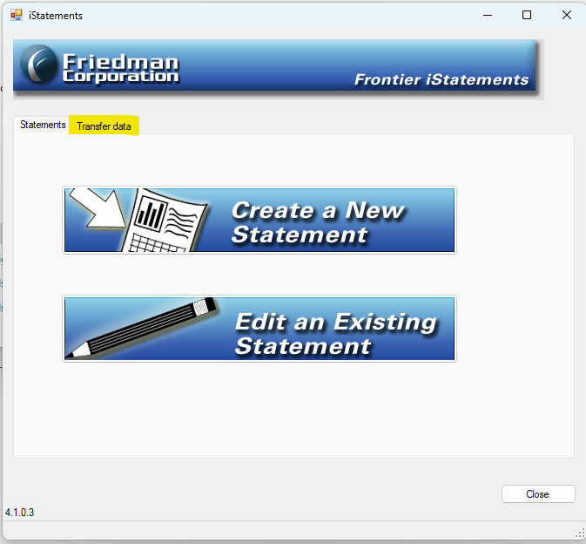
Importing Data
  On the iStatements screen click the Transfer Data tab.

Slide 23
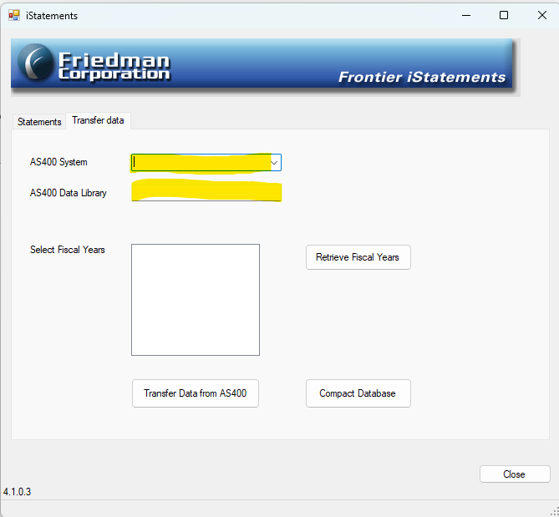
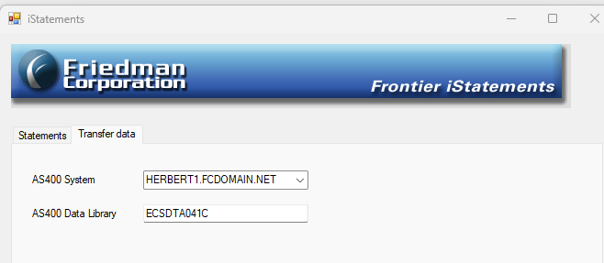
Importing Data
  When it is done installing the VBExcel the window will say it was successfully installed. Click Close.
  In the AS400 System box enter your AS400 system name or IP address
  In the AS400 Data Library enter your system Data Library.

Slide 24
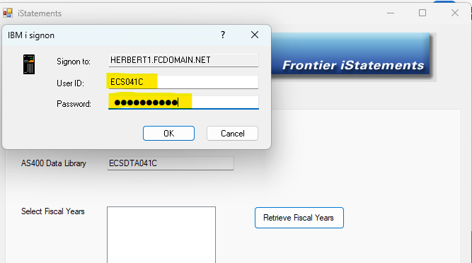
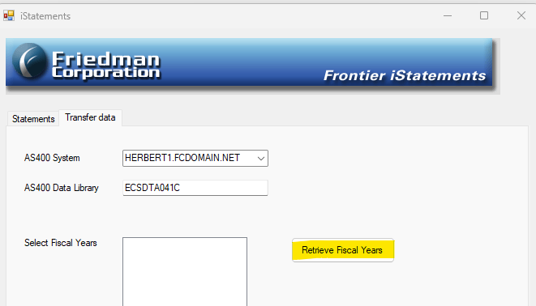
Importing Data
  Click the Retrieve Fiscal Years
  You may get a popup box to log into your AS400. Enter the user id and password you use to log into you AS400 system. Click ok.

Slide 25
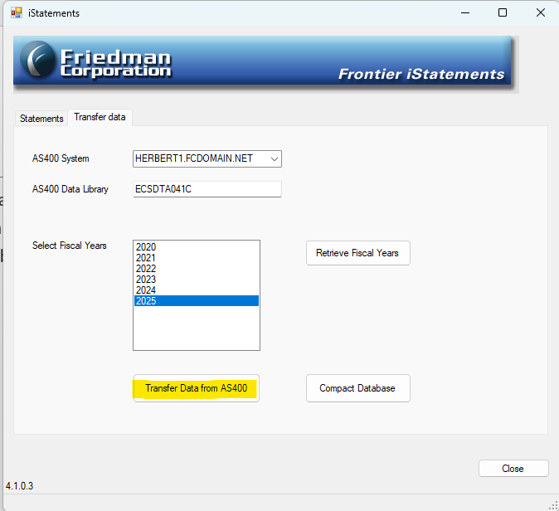
Importing Data
  Now the years that option 901 on MEMENU has been run for will display on the screen.
  Select the year that you want to get the data for and click Transfer data.

Slide 26
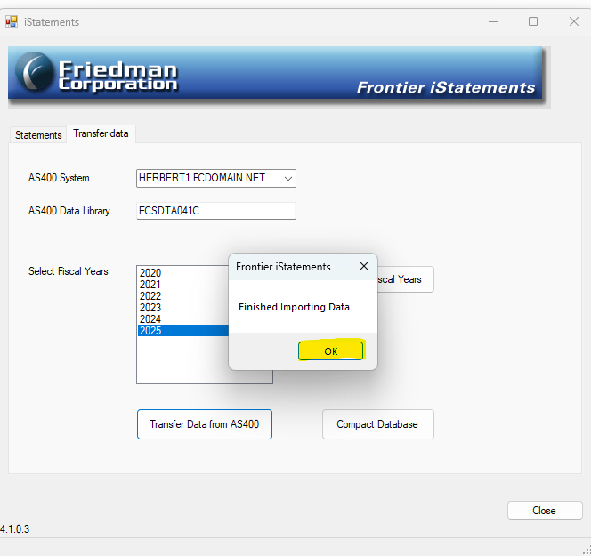
Importing Data
  When the transfer is complete a popup box will appear saying it is Finished Importing Data.
  Click Ok.
  Then select the next year you want to do the transfer of data on.
  When done transferring all your data you can close the iStatement program.

Slide 27
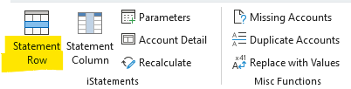
iStatements
  Now you are ready to open Excel and create a new spreadsheet or open an existing spreadsheet.
  Verify that the Add Ins is listed on the toolbar. Click on Add Ins.
  Make sure Statement Row displays along with the rest of options on the screen shot below.

Slide 28
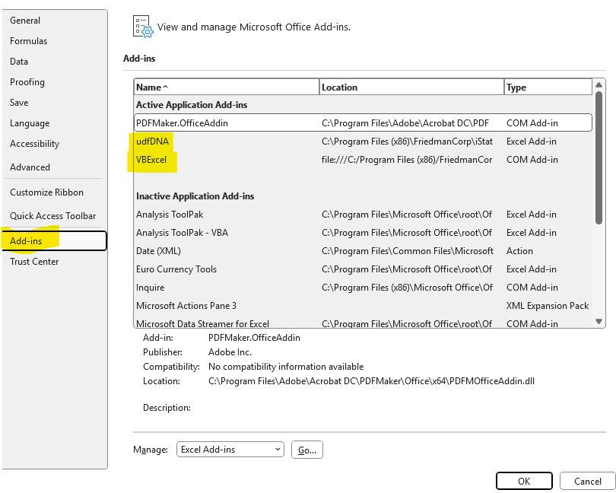
iStatements
  If the Add Ins does not appear on the toolbar, then click on File, Options, and then Add ins.
  You want to make sure the udfDNA and VBExcel are listed in the Active Application Add-Ins section.
  If they are not listed check the Inactive App list and the Disabled list. If in one of these lists, then active the option or enable it so that it will appear in the active list.
  If it does not appear anywhere in this screen the go to Control Panel, Programs and Features and confirm if VBExcel is listed. If not, call the Friedman Helpdesk.

Slide 29
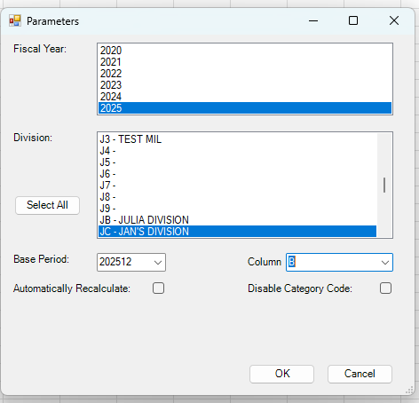
iStatements
  To update an existing spreadsheet, click on Parameters and update the fiscal period.
  If creating a new spreadsheet, click on Parameters and select the year, the division(s), fiscal period and column you want your account numbers to be listed. Click Ok.

Slide 30
Questions
  If you have any questions, please don’t hesitate to call the helpdesk at 847-948-7180 ext 7 or submit a ticket via our client portal.

Slide 31
Book a Discovery Call

